Slide 1



Chest X-ray Abnormalities Detection

Slide 2
Kulkarni Ganesh Shivajirao
ED16B016
InuAid Solutions Pvt. Ltd
Guide : Ganapathy Krishnamurthi

Slide 3
Objective and Scope
Identify and localize findings on chest radiographs
Relieves busy doctors' stress
Provides patients the precise diagnosis.
Notes:
An automated system which could accurately identify and localize findings on chest radiographs which would relieve busy doctors' stress while also providing patients with a more accurate diagnosis.

Slide 4
Motivation
Existing methods of evaluation
Lack of specification of locations leads to inexplicable outcomes
A solution for localizing abnormalities provides diagnostic assistance
Notes:
Existing methods of evaluating chest X-ray images are to classify them into a list of conclusions. Lack of specification of their locations on the image, which sometimes leads to inexplicable outcomes. A solution for localizing abnormalities on the chest X-ray images is required for providing doctors with more meaningful diagnostic assistance.

Slide 5
Problem Statement
Preprocess the dataset
Deployment of the DL models for the object detection tasks
Faster RCNN
YOLOv5
Analysis of the results
The developments and improvements
Notes:
Problem statement split into list of sub problems
Here are the list

Slide 6
Introduction

Slide 7
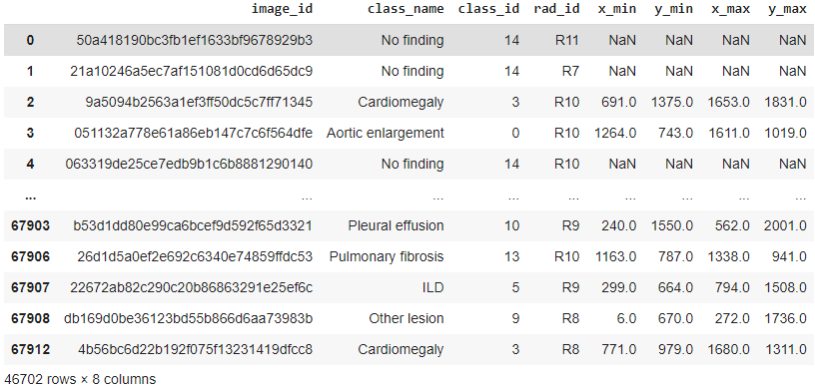
VinBig Dataset
Classifying thoracic lung diseases
Localizing 14 critical radiographic findings
17 experienced radiologists manually annotated
15000 DICOM images with labels
3000 DICOM images for testing
Notes:
In this detection challenge, they have provided VinBig dataset.
This dataset is collected from two major hospitals in Vietnam. Out of this raw data, we release 18,000 images manually annotated by 17 experienced radiologists with 22 local labels of rectangles surrounding abnormalities
It classifies and localize 14 different finding s in radiograph

Slide 8
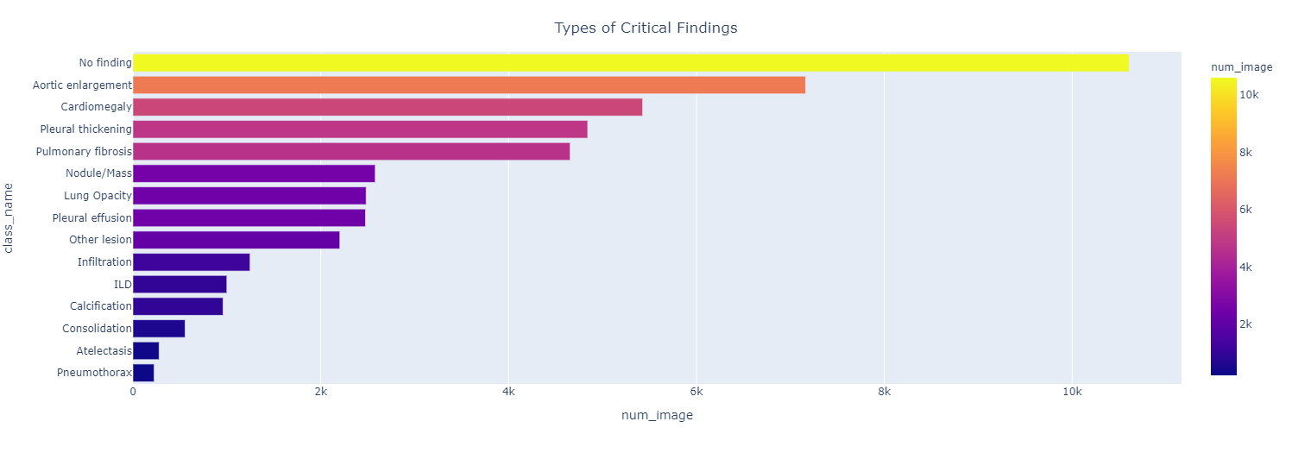
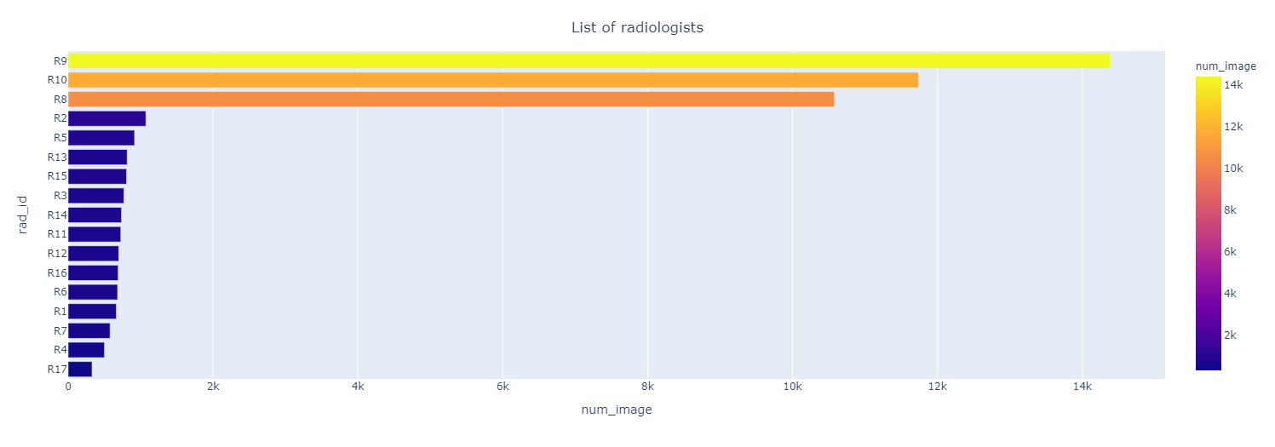
VinBig Dataset
Class distribution to number of images
Radiologist distribution to number of images
Imbalanced dataset
Annotations are less for some classes

Slide 9
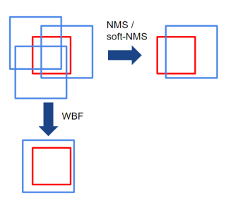
Ensemble Method
Ensembling the prediction of the models
NMS and WBF ensemble methods
WBF consider all boxes and take average
NMS removes some boundary boxes
Parameters taken into consideration are
Intersection over Union threshold
Confidence score threshold
Prediction by WBF more accurate than NMS

Slide 10
Methods and Results

Slide 11
YOLO Object Detection

Slide 12
Image Conversion
The Input Images are in DICOM
YOLO does not support DICOM format
Converted DICOM Images to PNG Images
PNG Images with 16 Bits depth, Monochrome and Grayscale
(1024, 1024) size of PNG image

Slide 13
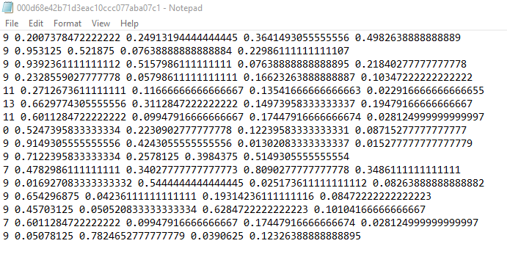
Annotation Conversion
Calculate original Image size
Recalculate annotations based on resized image
Calculate (x center, y center, height, weight) using updated annotation values
Create text file with image identity and save Yolo format values
Used abnormalities class id from 0 to 13

Slide 14
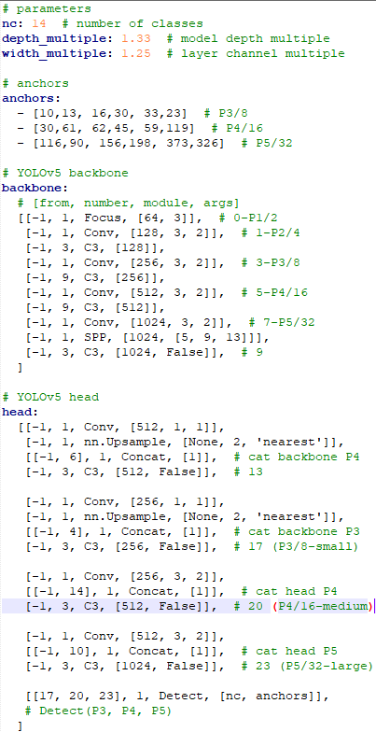
YoloV5 Model
12000 Images for training and 3000 Images for validation
Data Yaml file with address for train and validation images
Pretrained YoloV5x model build with CSP densenet 53 backbone and PA-NET Neck
284 layers with 89 Million parameters

Slide 15
YoloV5 Model Train
Sr. No. | Hyperparameter | Value | Description
1 | Epochs | 200 | Epochs size
2 | Batch Size | 16 | Images at each batch
3 | Image size | 1024 | [train, test] image sizes
4 | Workers | 8 | maximum number of data loader workers
5 | lr0 | 0.01 | Initial learning rate (SGD1E-2, Adam1E-3)
6 | lrf | 0.2 | final OneCycleLR learning rate (lr0 * lrf)
7 | momentum | 0.937 | SGD momentum/Adam beta1
8 | weight_decay | 0.0005 | optimizer weight decay 5e-4
9 | box | 0.05 | box loss gain
10 | cls | 0.5 | Class loss gain
11 | obj | 1.0 | Object loss gain
12 | iou_t | 0.20 | IoU training threshold
13 | anchor_t | 4.0 | anchor-multiple threshold
14 | Pretrained model | yolov5x | pretrained model configuration with weight file
15 | Optimizer | Adam | adam or SGD optimizer
16 | number of channels | 15 | number of classes start from 0 (excluding background)

Slide 16
Ensemble
Generated results on test dataset with each model:
Inference Image Size in pixel: 640
Intersection over Union threshold for NMS: 0.25
Object confidence threshold: 0.01
Pretrained model weight: best.pt (based on best validation mAP)
Use WBF to ensemble all generated results:
Intersection over union threshold for WBF: 0.4
Skipping boxes threshold for WBF: 0.0001

Slide 17
Single YoloV5
Model Training

Slide 18
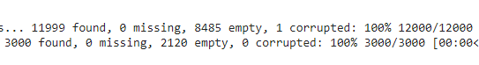
Model I Train
Trained with default hyperparameters
Yolo format input dataset
Healthy Images with empty text files
8485 empty text files for training
2120 healthy images for validation
Pretrained model for the training

Slide 19
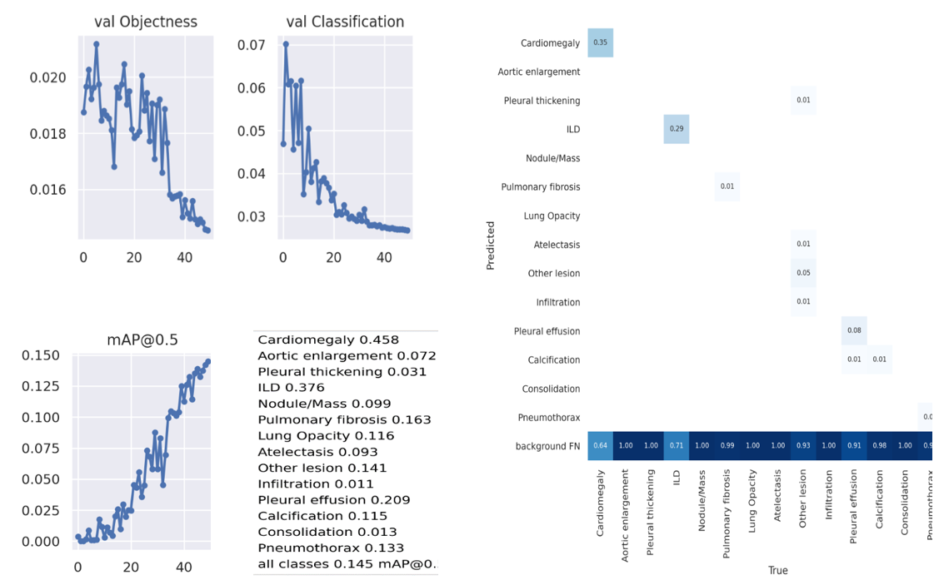
Model I Results

Slide 20
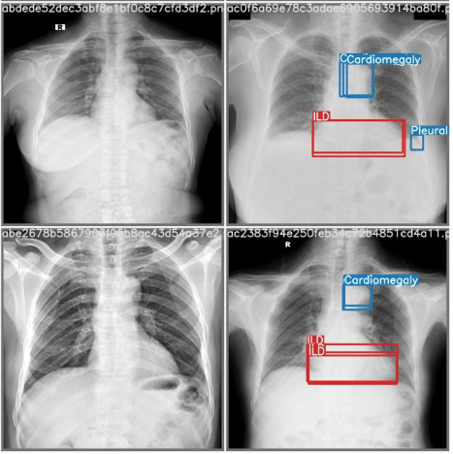
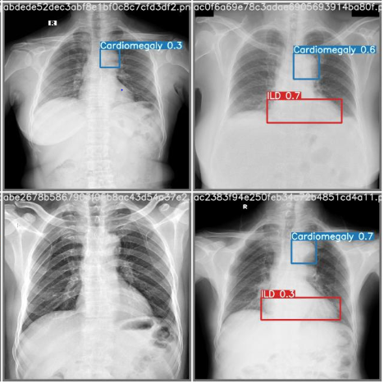
Model I Prediction
True | Prediction

Slide 21
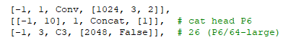
Model II Train
Epochs 200
Updated the YoloV5x model configuration
Rest default hyperparameters
Random initialization of weights

Slide 22
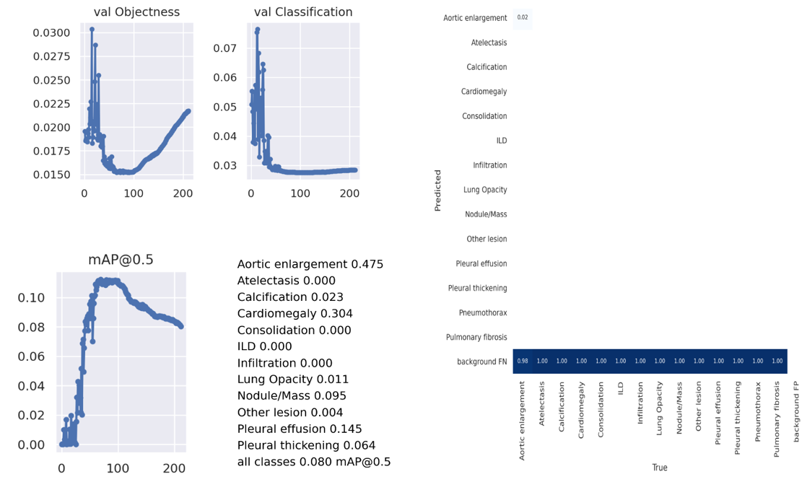
Model II Results

Slide 23
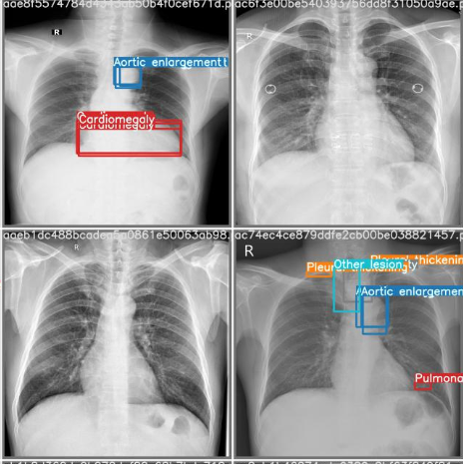
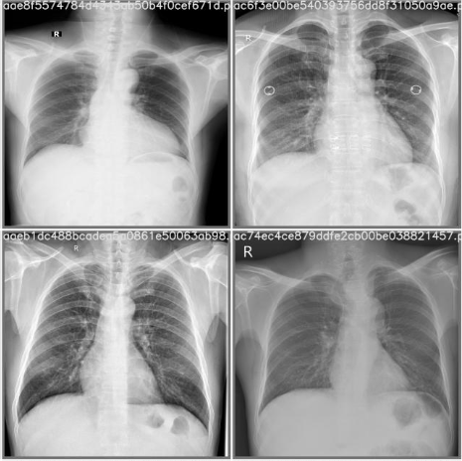
Model II Prediction
True | Prediction

Slide 24
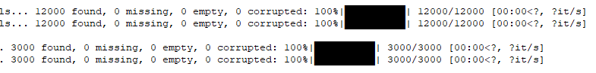
Model III Train
Batch Size 28
Full boundary boxes for healthy images
Class identity 14 with “No Findings”
Number of channels 15
Pretrained YoloV5x model
Kept other hyperparameters same

Slide 25
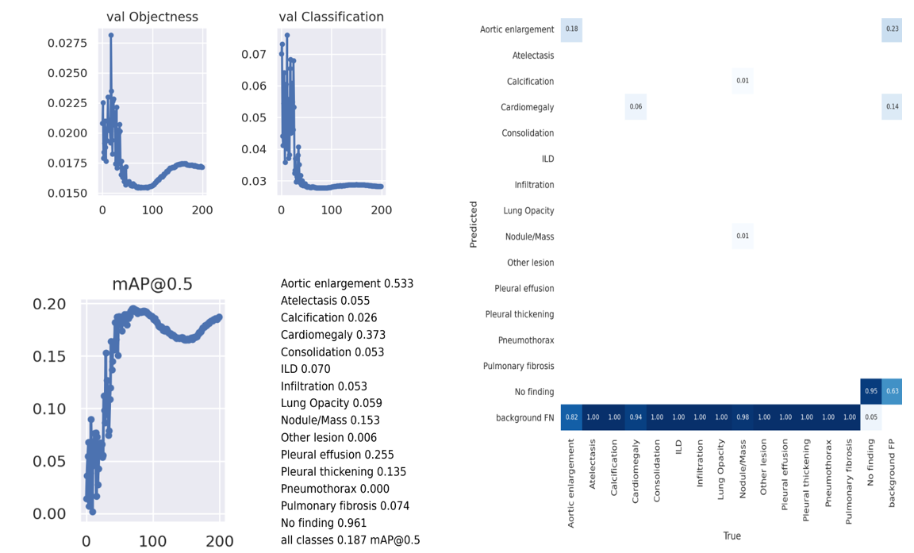
Model III Results

Slide 26
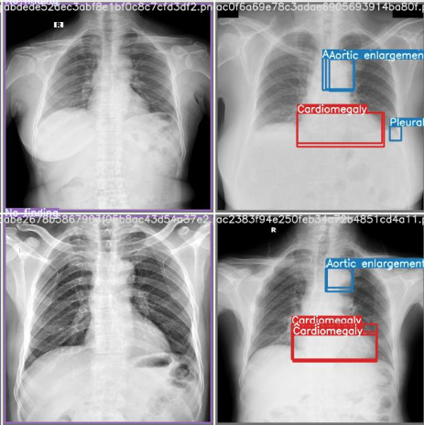
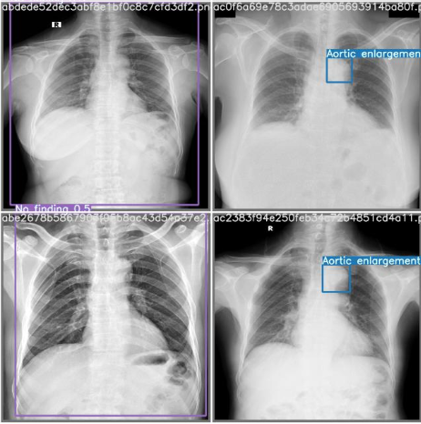
Model III Prediction
True | Prediction

Slide 27
Model IV Train
Image size 512
Batch Size 64
Initial learning rate 0.005
Full boundary boxes for healthy images
Kept other hyperparameters same

Slide 28
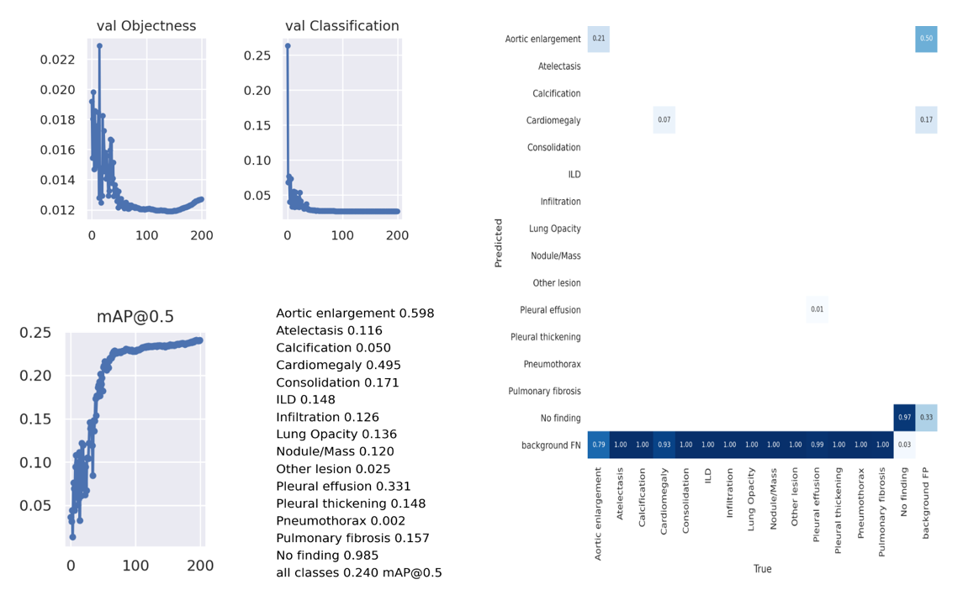
Model IV Results

Slide 29
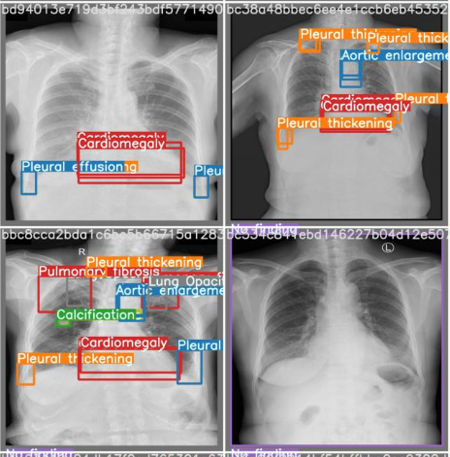
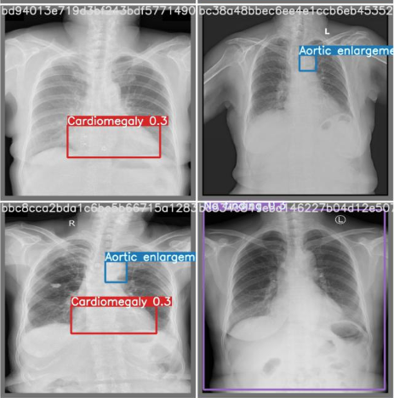
Model IV Prediction
True | Prediction

Slide 30
Model VI Train
Image size 640
Batch Size 40
Initial learning rate 0.005
Empty text files for healthy images
Number of channels 14
Kept other hyperparameters same

Slide 31
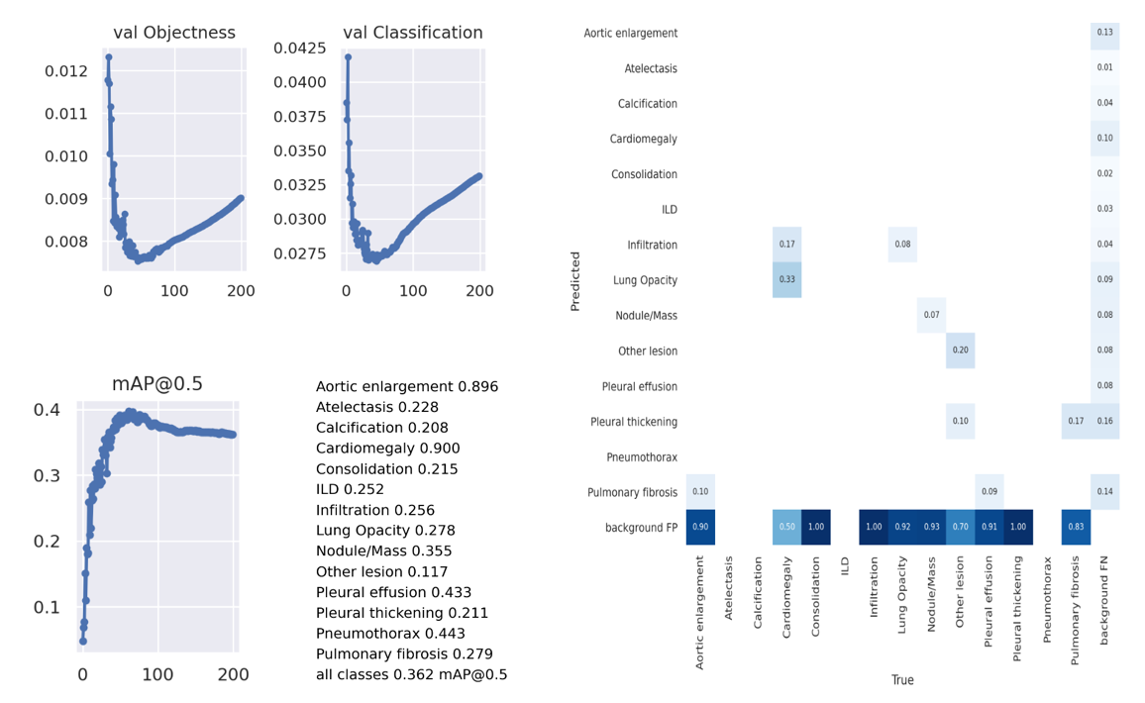
Model VI Results

Slide 32
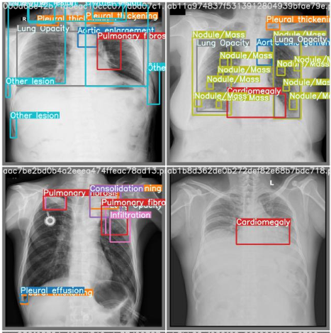
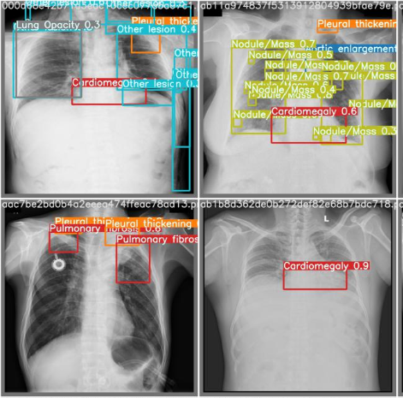
Model VI Prediction
True | Prediction

Slide 33
Result Analysis
Method | Models | Best validation mAP | Kaggle Test mAP
Single Model Training | Model I | 0.145 | 0.080
 | Model II | 0.110 | 0.063
 | Model III | 0.187 | 0.085
 | Model IV | 0.240 | 0.110
 | Model VI | 0.362 | 0.201
Analyzed single based training model and improvements in models
Single model achieved best mAP of 0.201 on test dataset
Some classes have less mAP
Improvements of those classes are needed

Slide 34
Partial Classes Training

Slide 35
YoloV5 Model
Split the dataset based on number of instances for each class
Trained each model with these dataset using given hyperparameters
Ensemble the results of every model
All healthy images are used in every partially class yolov5 training model
Batch Size 40
Image Size 640
Learning rate 0.01
SGD optimizer
Yolov5x pretrained model
Empty text files for healthy images
Number of channels 14
Other hyperparameters kept default

Slide 36
Partial Classes
Sr. No. | YoloV5 Model | Selected Class Names | Original Class Identities | Temporary Class Ids for training | Number of instances
1 | Model 1 | ['Aortic enlargement', 'Cardiomegaly', 'Pleural thickening', 'Pulmonary fibrosis'] | [0,3,11,13] | [0,1,2,3] | [7162, 5427, 4842, 4655]
2 | Model 2 | [‘Atelectasis’, ‘Consolidation’, ‘Pneumothorax’] | [1,4,12] | [0,1,2] | [279, 556, 226]
3 | Model 3 | [‘Calcification’, ‘ILD’, ‘Infiltration’] | [2,5,6] | [0,1,2] | [960, 1000, 1247]
4 | Model 4 | ['Lung Opacity', 'Nodule/Mass', 'Other lesion', 'Pleural effusion',] | [7,8,9,10] | [0,1,2,3] | [2483, 2580, 2203, 2476]

Slide 37
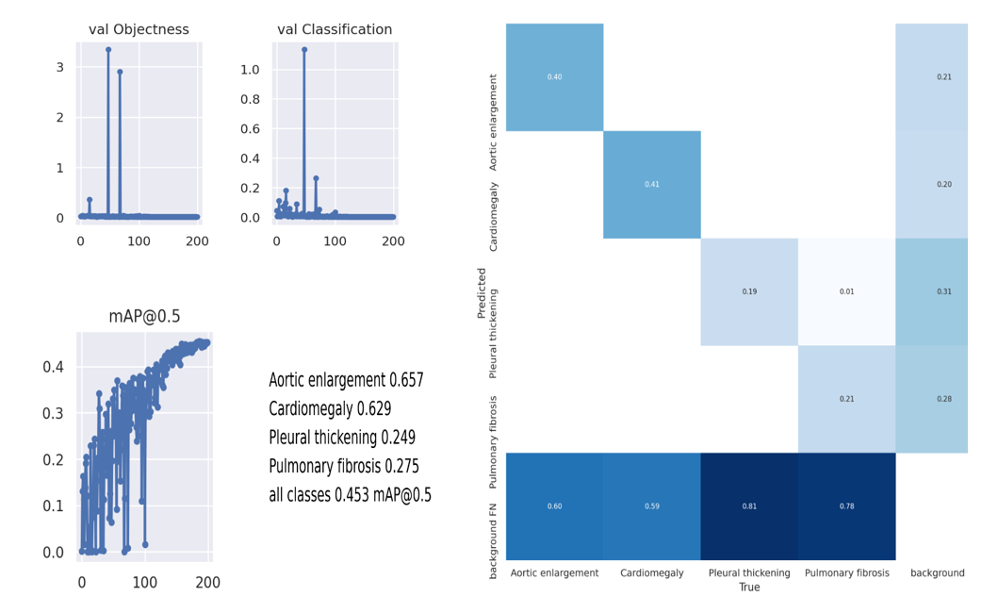
Model 1 Results

Slide 38
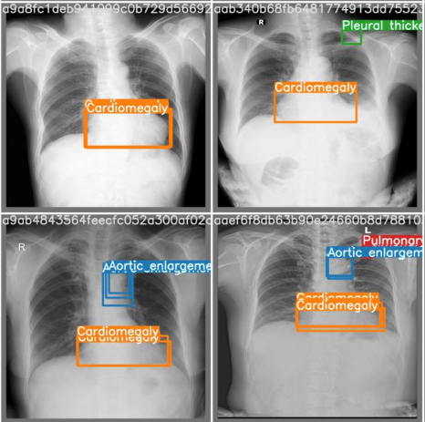
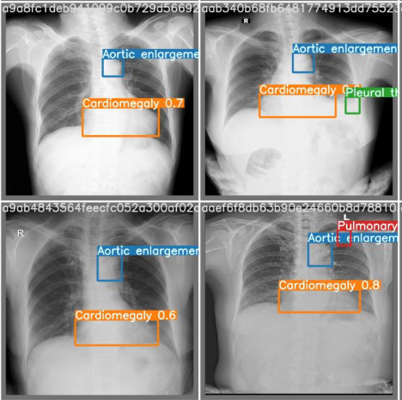
Model 1 Prediction
True | Prediction

Slide 39
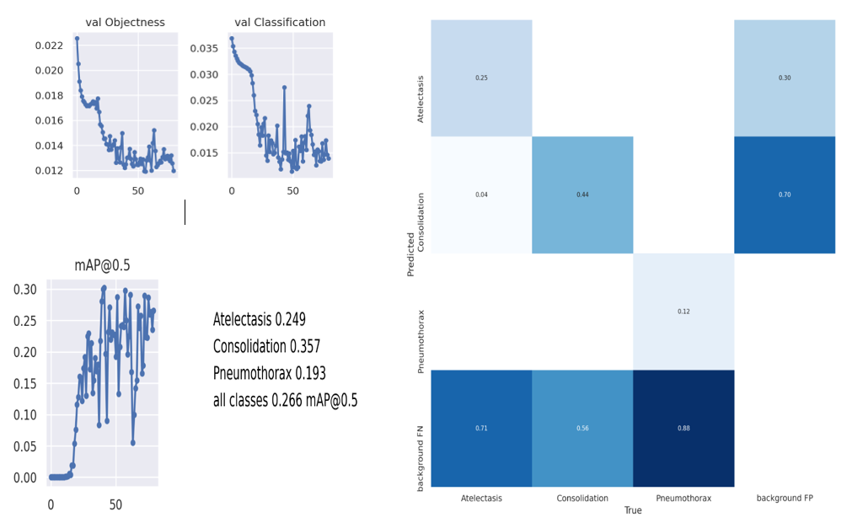
Model 2 Results

Slide 40
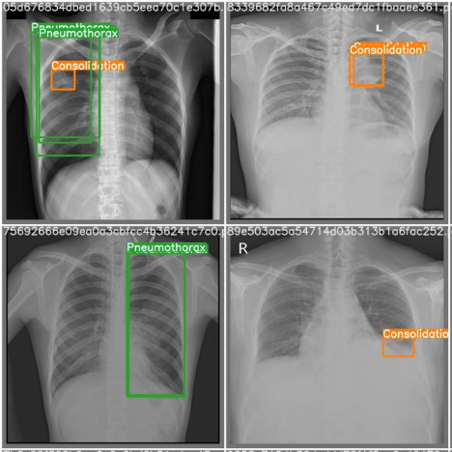
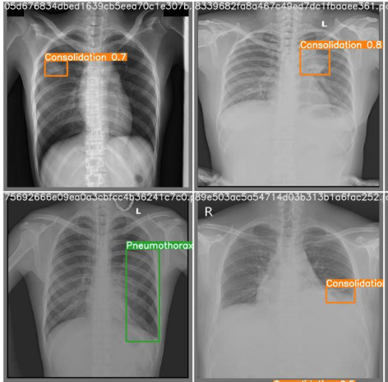
Model 2 Prediction
True | Prediction

Slide 41
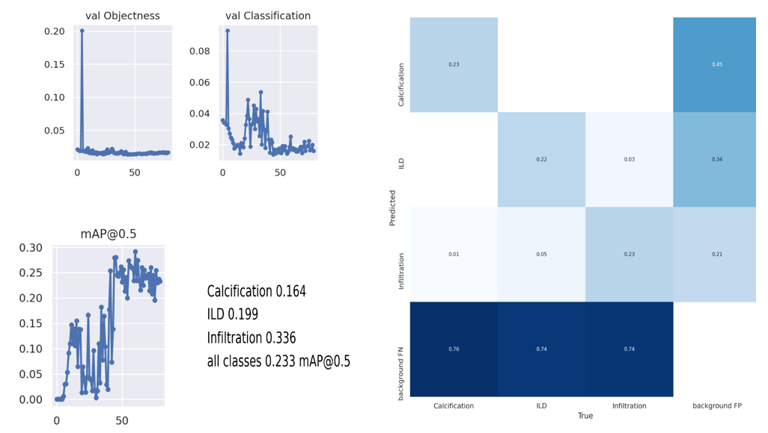
Model 3 Results

Slide 42
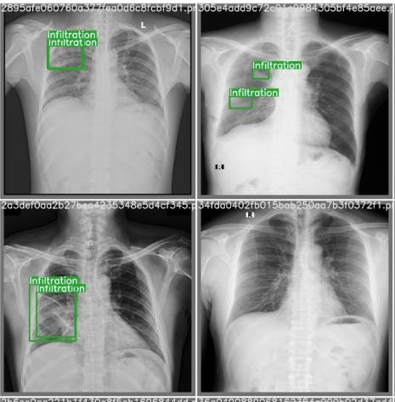
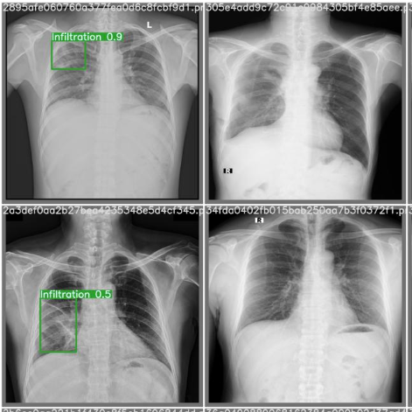
Model 3 Prediction
True | Prediction

Slide 43
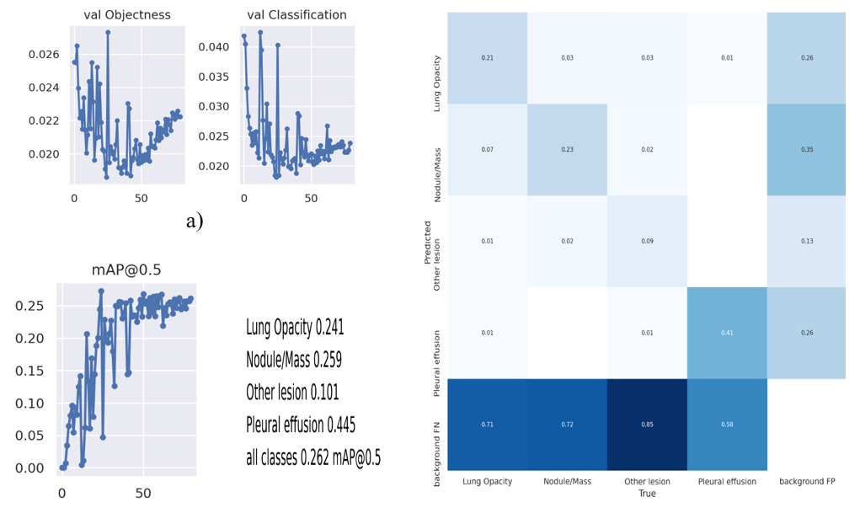
Model 4 Results

Slide 44
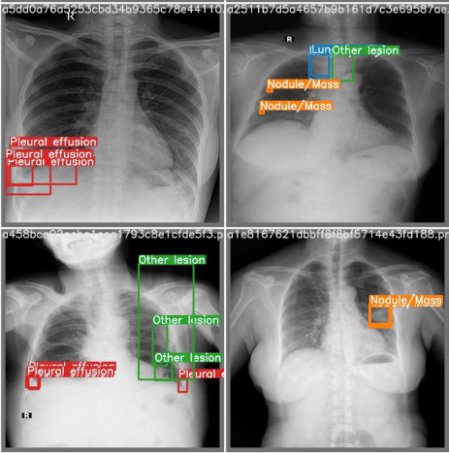
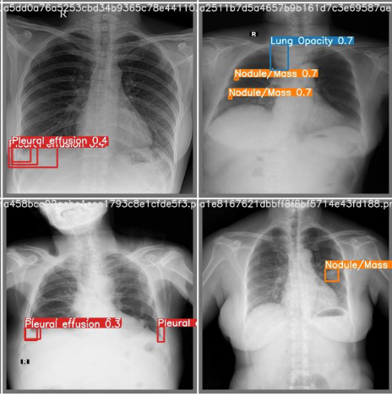
Model 4 Prediction
True | Prediction

Slide 45
Result Analysis
Method | Models | Validation mAP | Kaggle Test mAP
Partial classes training | Model 1 | 0.453 | 0.064
 | Model 2 | 0.266 | 0.026
 | Model 3 | 0.233 | 0.050
 | Model 4 | 0.262 | 0.066
 | Ensemble four models |  | 0.185
Tested every model and generated the results
Used Weighted Boxes Fusion ensemble to merge all generated results achieved 0.185 score on Kaggle
Improvement in mAP for classes, but increase false positive
Validation dataset is not helping for training

Slide 46
K Fold Method

Slide 47
K Fold YoloV5
Split image dataset into 5 folds, each with 3000 images and their annotations
Trained five yolov5 models with given hyperparameters
Used 4 folds for training and 1 fold for validation
All healthy images are used in every yolov5 training model
Batch Size 40
Image Size 640
Learning rate 0.01
SGD optimizer
Yolov5x pretrained model
Empty text files for healthy images
Number of channels 14
Other hyperparameters kept default

Slide 48
K Fold Models
Model Name | Train and Val Fold | Train Instances |  | Validation Instances
 |  | Found | Empty | Found | Empty
KModel 1 | Train : Fold 0, 1, 2, 3 Val : Fold 4 | 26697 | 8485 | 6628 | 2121
KModel 2 | Train : Fold 1, 2, 3, 4 Val : Fold 0 | 26561 | 8482 | 6764 | 2124
KModel 3 | Train : Fold 0, 2, 3, 4 Val : Fold 1 | 26563 | 8485 | 6762 | 2121
KModel 4 | Train : Fold 0, 1, 3, 4 Val : Fold 2 | 26845 | 8479 | 6480 | 2127
KModel 5 | Train : Fold 0, 1, 2, 4 Val : Fold 3 | 26634 | 8493 | 6691 | 2113

Slide 49
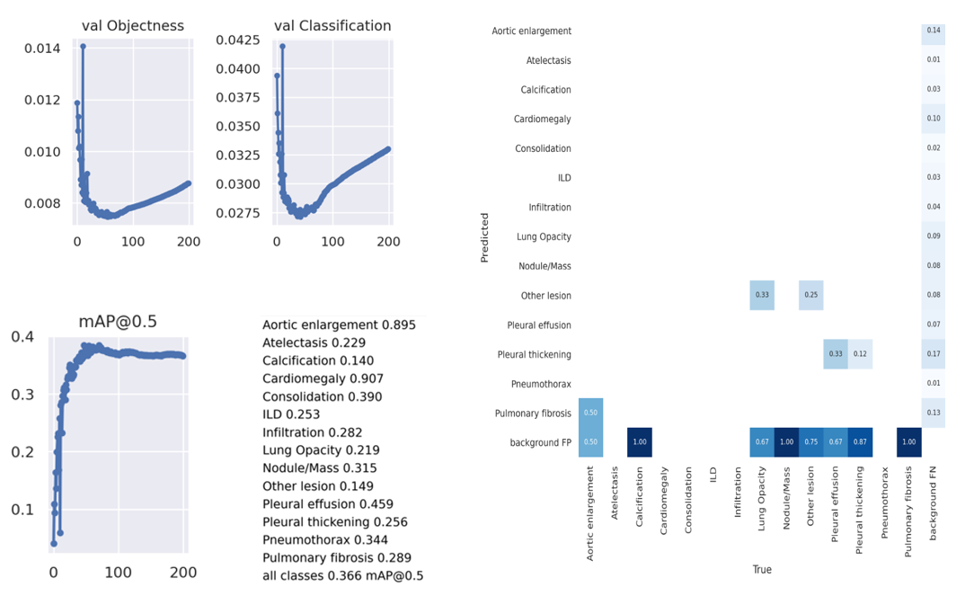
KModel 1 Results

Slide 50
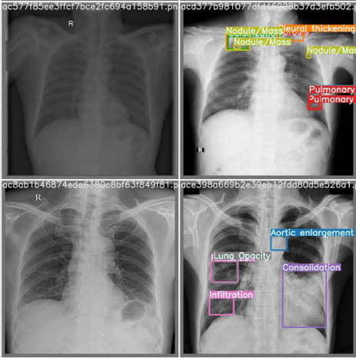
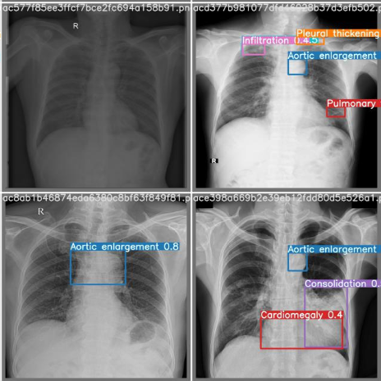
KModel 1 Prediction
True | Prediction

Slide 51
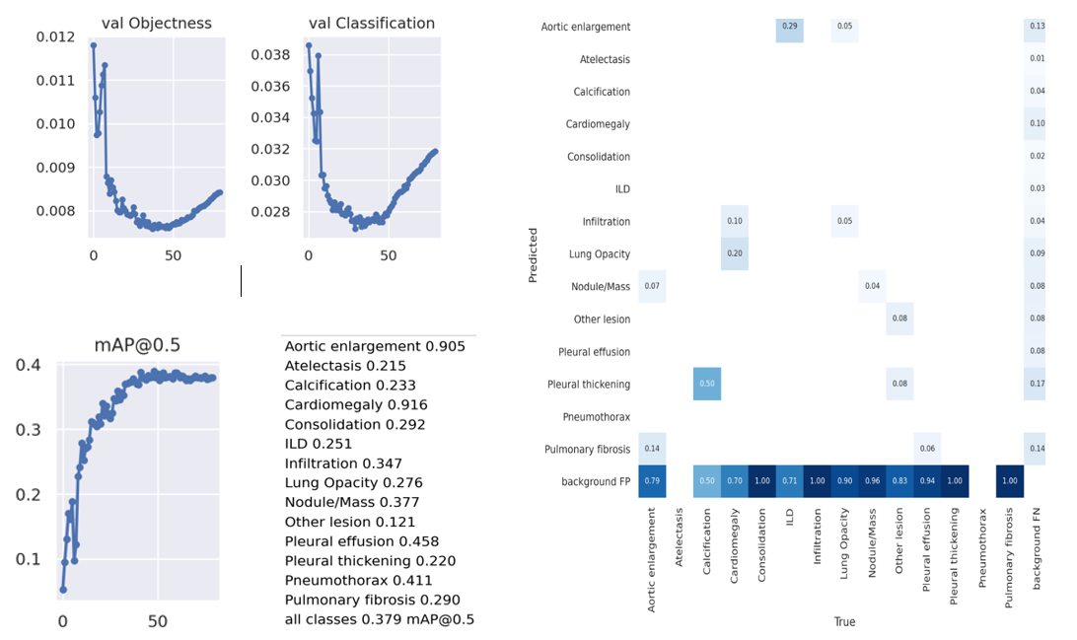
KModel 2 Results

Slide 52
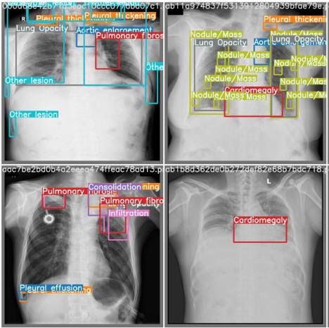
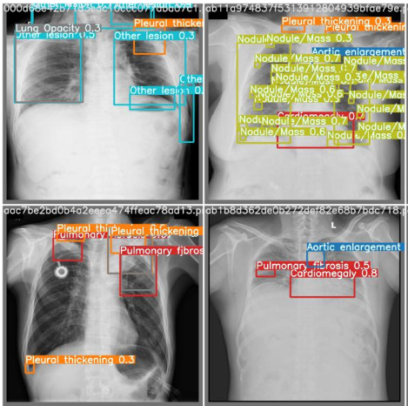
KModel 2 Prediction
True | Prediction

Slide 53
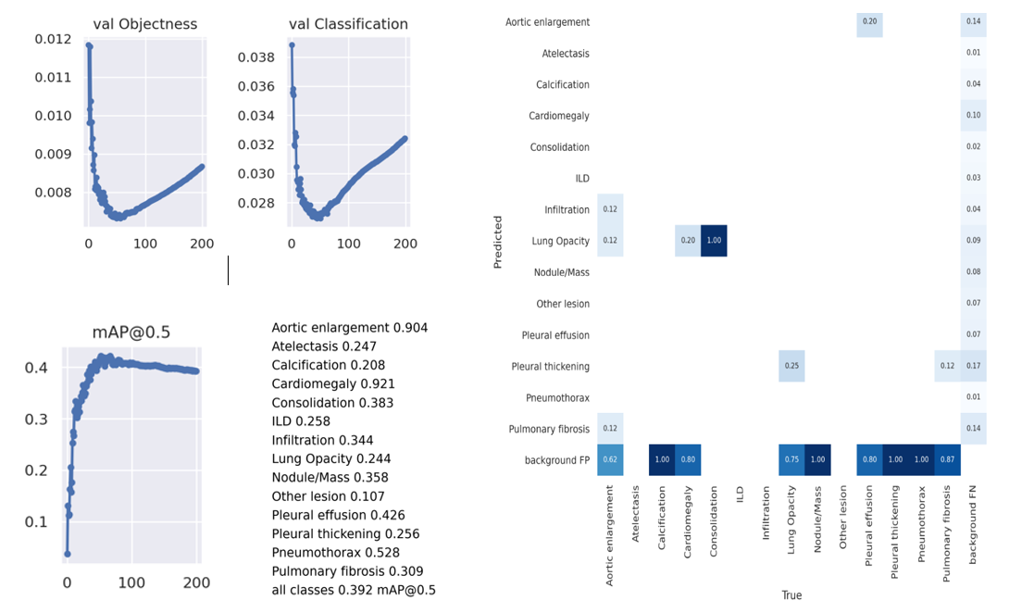
KModel 3 Results

Slide 54
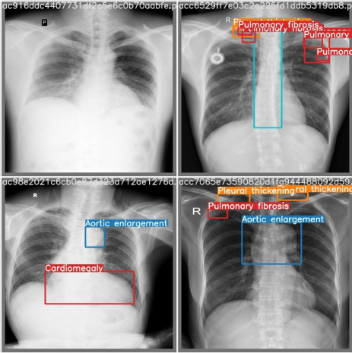
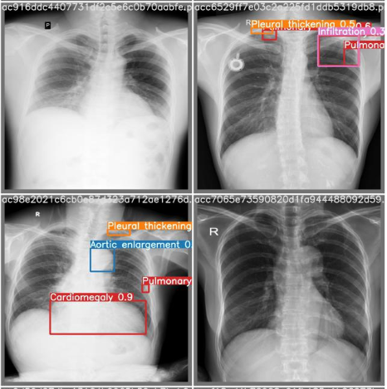
KModel 3 Prediction
True | Prediction

Slide 55
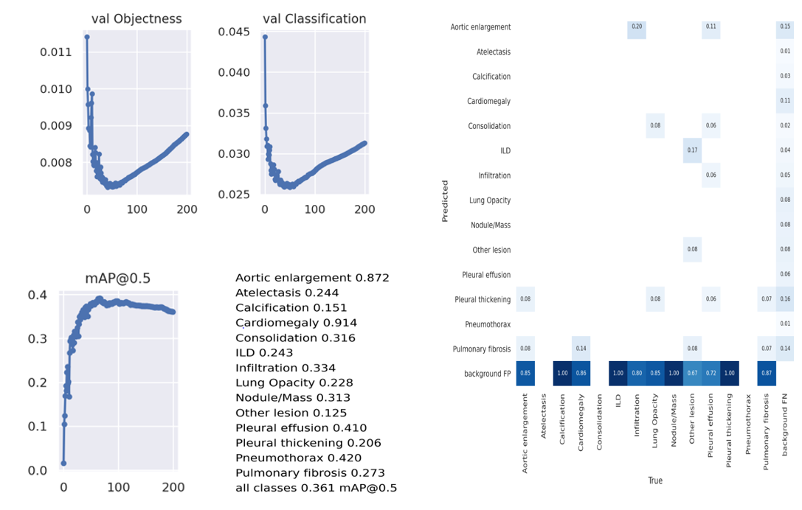
KModel 4 Results

Slide 56
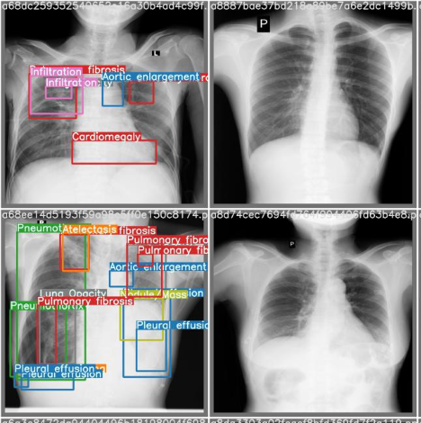
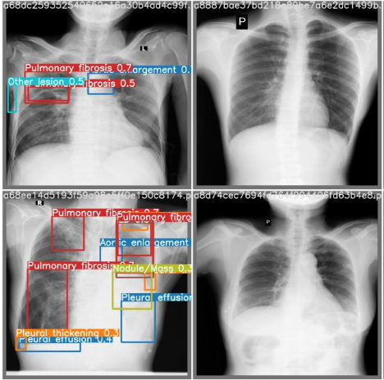
KModel 4 Prediction
True | Prediction

Slide 57
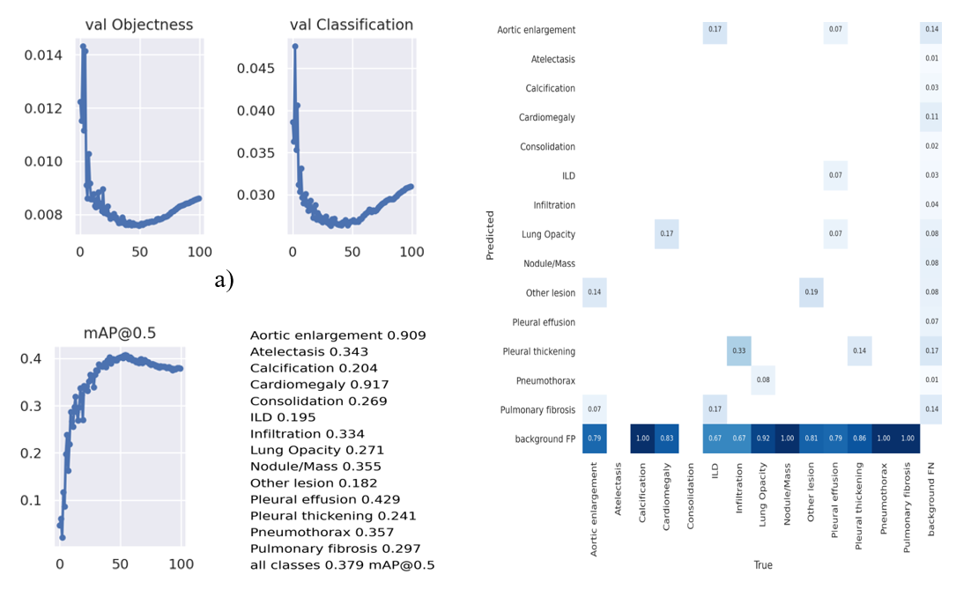
KModel 5 Results

Slide 58


KModel 5 Prediction
True | Prediction

Slide 59
Result Analysis
Method | Models | Best validation mAP | Kaggle Test mAP
K Fold Method | KModel 1 | 0.3724 | 0.209
 | KModel 2 | 0.3896 | 0.212
 | KModel 3 | 0.4219 | 0.214
 | KModel 4 | 0.3917 | 0.216
 | KModel 5 | 0.4073 | 0.212
 | Ensemble five models |  | 0.256
Used WBF ensemble to merge all generated results achieved 0.256 score on Kaggle
Aggregate mAP of 5 models of radiologist R8. R9, and R10 are good as compare to rest of radiologists
Radiologist Identity | Aggregate mAP of five models
R 8 | 0.99
R 9 | 0.95
R 10 | 0.97
R 11 | 0.37
R 12 | 0.01
R 13 | 0.51
R 14 | 0.52
R 15 | 0.27
R 16 | 0.50
R 17 | 0.44

Slide 60
Stage 2 YoloV5
Images from R8, R9 and R10 radiologists are removed from previous five folds
Remaining annotated boxes was tripled using different three variants
Trained updated dataset with YoloV5 model using K Fold method
Used previous pretrained model to training stage 2 K fold YoloV5 models
Used same hyperparameters as previous

Slide 61
Stage 2 Results
Method | Models | Best validation mAP
Stage 2 YoloV5 Method | Stage2 KModel 1 | 0.1665
 | Stage2 KModel 2 | 0.2148
 | Stage2 KModel 3 | 0.2027
 | Stage2 KModel 4 | 0.1370
 | Stage2 KModel 5 | 0.2436
 | Ensemble five models (Kaggle Test mAP) | 0.212
Used WBF ensemble to merge all generated results achieved 0.212 score on Kaggle
mAP of rest of radiologist improved
Overall performance of the model decreased
Radiologist Identity | Aggregate mAP of five models
R 11 | 0.55
R 12 | 0.35
R 13 | 0.48
R 14 | 0.62
R 15 | 0.34
R 16 | 0.50
R 17 | 0.45

Slide 62
Faster RCNN Object Detection

Slide 63

Faster RCNN
Used DICOM Images for training Faster RCNN model
Converted annotations into standard COCO format
Created JSON file with annotations and image information
Used Healthy images as background class with class identity 0.
Used abnormalities class id from 1 to 14
Gave full boundary boxes to healthy images

Slide 64
Faster RCNN Training
Used 12000 DICOM images for training and 3000 for the validation
Provide annotation in COCO format with json file
Used Resnet101 backbone, pretrained on ImageNet
Learning rate 0.00025
Iteration 50000
Multistep LR
Number of classes 15 (including background)
Batch size 2
Images size 1024
Head batch size 512
Evaluation 1000
Kept other hyperparameters as default

Slide 65



Faster RCNN Results

Slide 66

Results
Generated results of Faster RCNN
Ensemble single generated results using WBF method
Method | Models | Validation mAP | Kaggle Test mAP
Faster RCNN | Single based trained model | 0.275 | 0.172

Slide 67
Conclusion
Tuning the hyperparameters helps to improve the score from 0.080 to 0.201
Analyzed the Dataset and work of a partially classed dataset helped to improve the score to 0.185
Score using the K fold method boosts the performance, achieving a score of 0.256
Ensembling K fold method results with partial classes trained results to improve the best mAP score from 0.256 to 0.269.

Slide 68
Conclusion
Analyzed the mAP of radiologists and worked to improve them. The score received is 0.212
Ensembling stage 2 K fold results with previous ensembles boosted the mAP score to from 0.269 to 0.273
Trained DICOM images on Faster RCNN received a score of 0.172
Ensembling with WBF to this results with the previous ensembled results boosted the mAP score value to 0.279

Slide 69
Conclusion
Method | Type | Kaggle Test mAP | mAP after Ensemble
YoloV5 | Partial classes training | 0.192 | 0.279
YoloV5 | K fold training | 0.21
YoloV5 | Stage 2 training | 0.212
Faster RCNN | Single model training | 0.185
Achieved 0.279 mAP score on test dataset on Kaggle
Got score equivalent to 24th Rank out of 1300 teams, and received results are within the top 2% of the teams

Slide 70
References
Object Detection in 20 Years: A Survey Zhengxia Zou, Zhenwei Shi, Member, IEEE, Yuhong Guo, and Jieping Ye, Senior Member, IEEE
You Only Look Once: Unified, Real-Time Object Detection (Redmon et al., 2017)
Faster R-CNN: Towards Real-Time Object Detection with Region Proposal Networks Shaoqing Ren, Kaiming He, Ross Girshick, and Jian Sun (Shaoqing Ren et al., 2016)
VinDr-CXR: An open dataset of chest X-rays with radiologist's annotations (Ha Q. Nguyen et al., 2021)

Slide 71
References
CSPNET: A NEW BACKBONE THAT CAN ENHANCE LEARNING CAPABILITY OF CNN (Chien-Yao Wang et al., 2019)
Weighted boxes fusion: Ensembling boxes from different object detection models (Roman Solovyev et al., 2021)
EfficientDet: Scalable and Efficient Object Detection (Mingxing Tan et al., 2020)
YOLOv3: An Incremental Improvement (Joseph Redmon et al., 2019)
Densely Connected Convolutional Networks (Gao Huang et al., 2018)

Slide 72
Thank You

